Slide 1
Hospital Management System
Nathan Bird
12/09/2024

Slide 2

Description/Business Purpose
The Hospital Management System helps hospitals run smoothly by keeping track of patient info, scheduling appointments, handling bills, and maintaining system resources. It makes it easier for staff to manage their work, reduces mistakes, and ensures patients get the best care possible.

Slide 3

Entity Relationship Diagram (ERD)

Slide 4
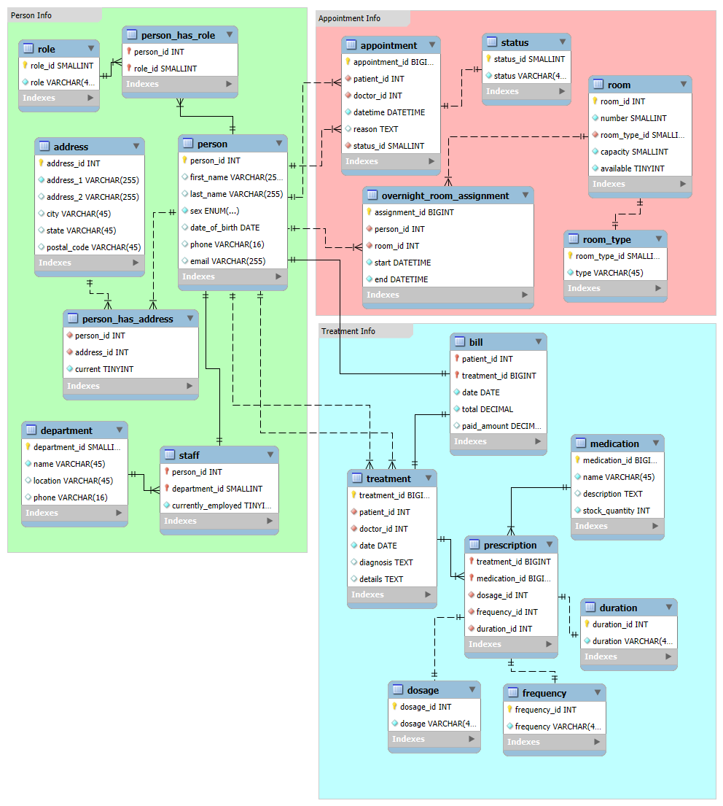
Don’t change slide on scroll
Don’t change slide on scroll

Slide 5


Slide 6
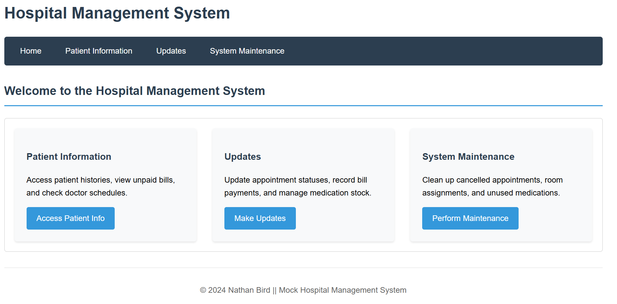
Interface Form Mockups
Notes:
Possible Hospital interface forms to interact with the hospital database.
https://nbird11.github.io/hospital-sql/

Slide 7
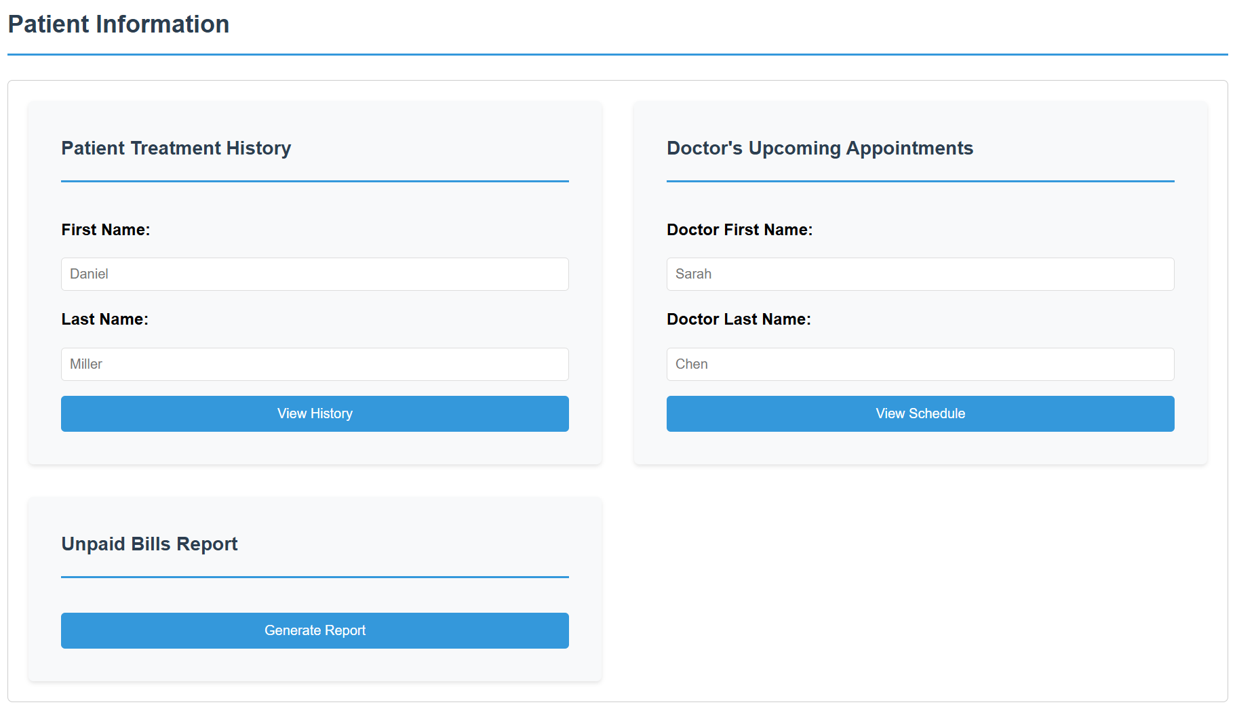
Notes:
https://nbird11.github.io/hospital-sql/patient-info.html
Find patient's complete treatment history
Find all patients with unpaid bills
Find upcoming appointments for specific doctor

Slide 8
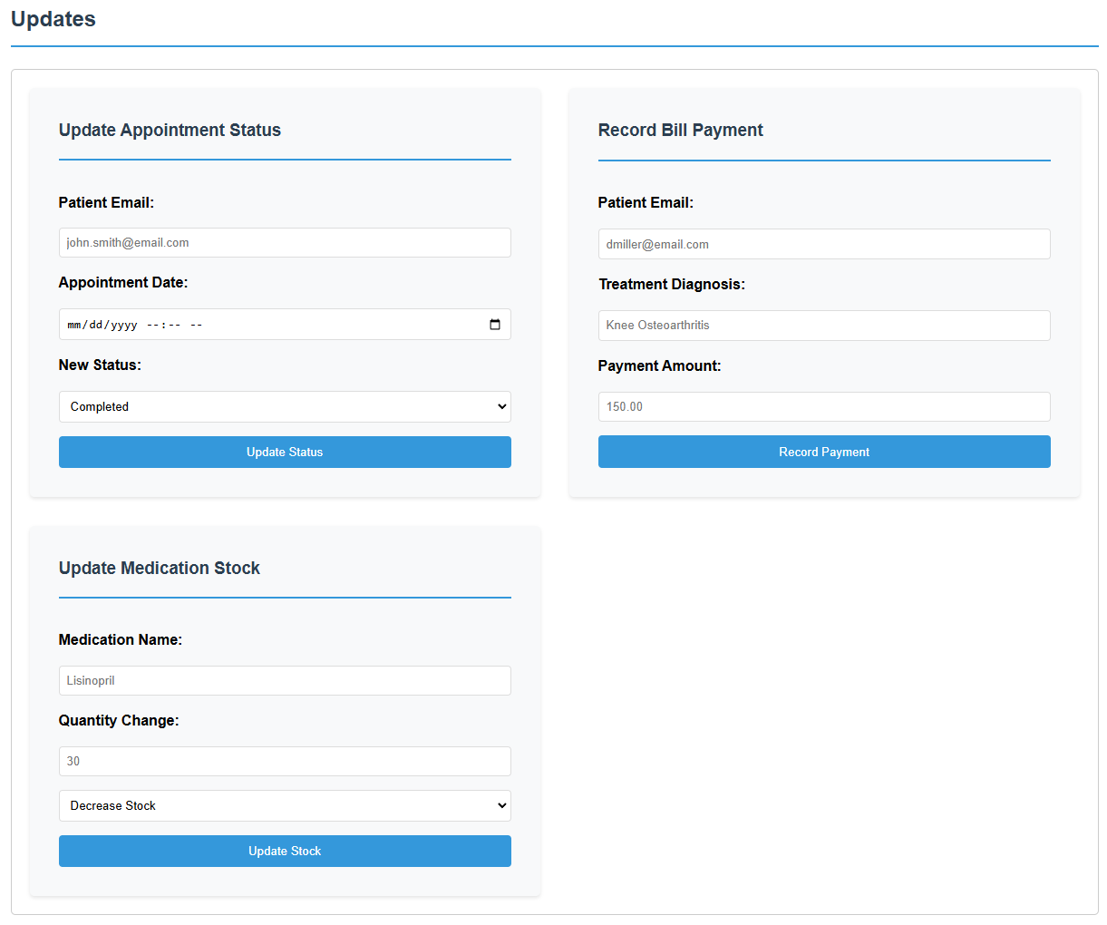
Notes:
https://nbird11.github.io/hospital-sql/updates.html
Update appointment status – e.g., patient was a no show
Update bill with new payment – e.g., patient made a payment
Update medication stock quantity – e.g., receive shipment or dispense medication

Slide 9
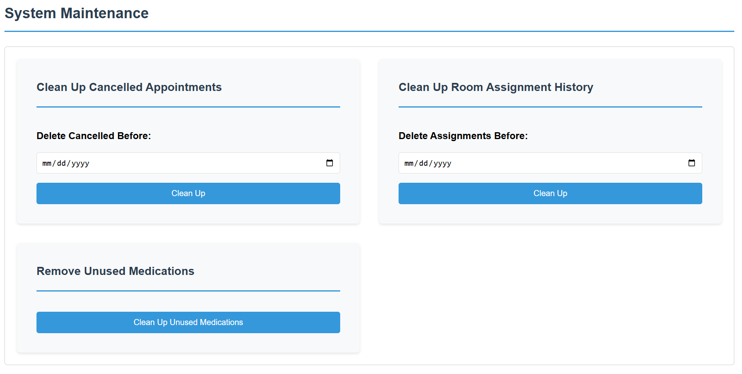
Notes:
https://nbird11.github.io/hospital-sql/maintenance.html
Delete cancelled appointments – e.g., cleaning up cancelled appointments older than X days that have no associated treatments
Delete expired room assignments – e.g., cleaning up room assignment history that's beyond retention requirements
Delete unused medication records – e.g., removing discontinued medications that were never prescribed

Slide 10

CRUD Samples

Slide 11
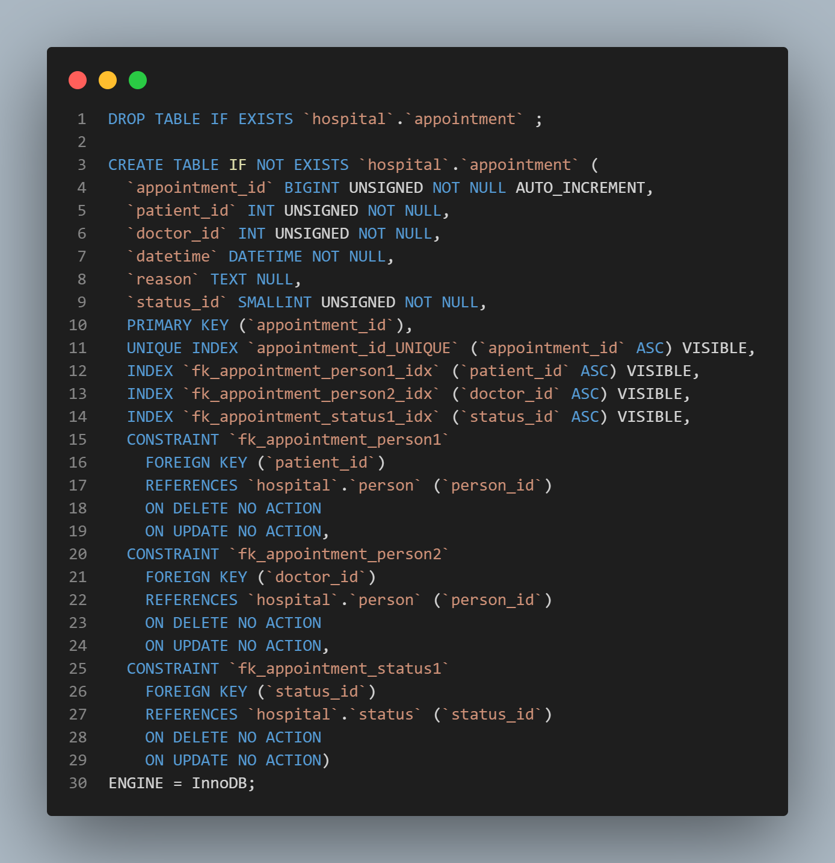
Appointment table creation
Generated by means of the Forward Engineer of the ERD model.

Slide 12
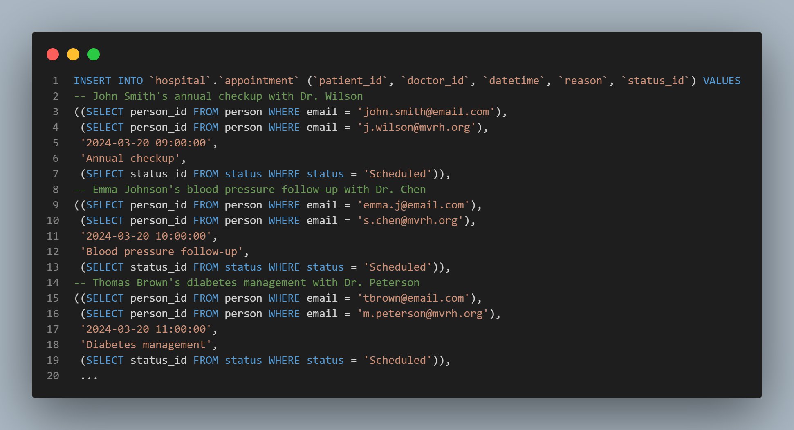
Appointment inserts
Note¹ – Depends on insertions for person table being run beforehand, i.e., order of the inserts matters.

Slide 13
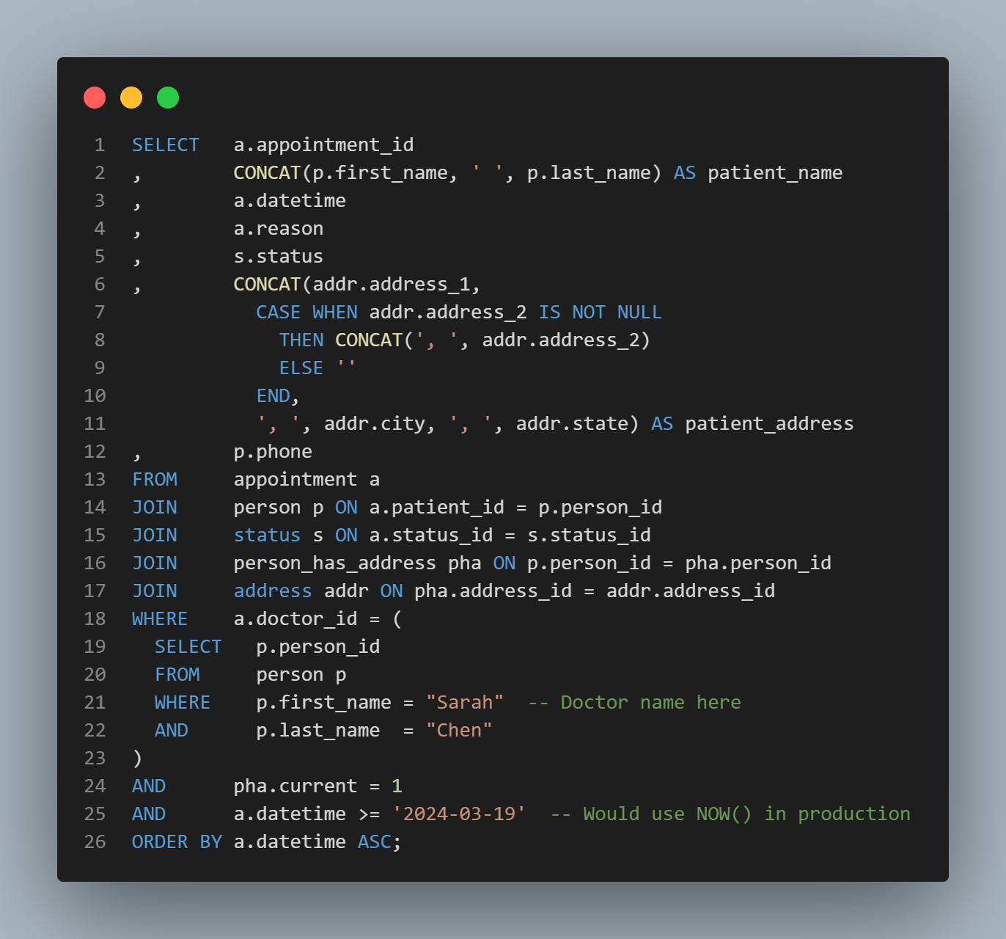
Find upcoming appointments for specific doctor
Real-world use: Doctor checking their daily/weekly schedule of patient appointments.
Note¹ – The WHERE subquery is where the name of the doctor would be passed in from the web form. [line 21-22]
Note² – In production, we'd use NOW() instead of a hardcoded date; using '2024-03-19' here to match our sample data. [line 25]

Slide 14
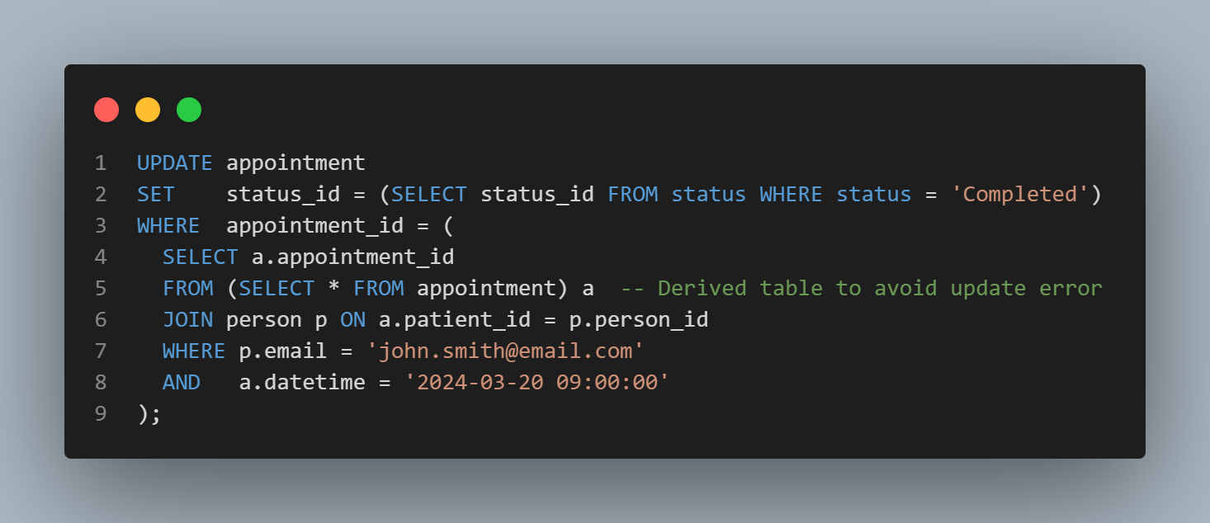
Update appointment status
Real-world use: Receptionist marking patient as arrived/completed/no-show.
Note¹ – New status passed in from web query in SET clause. [line 2]

Slide 15
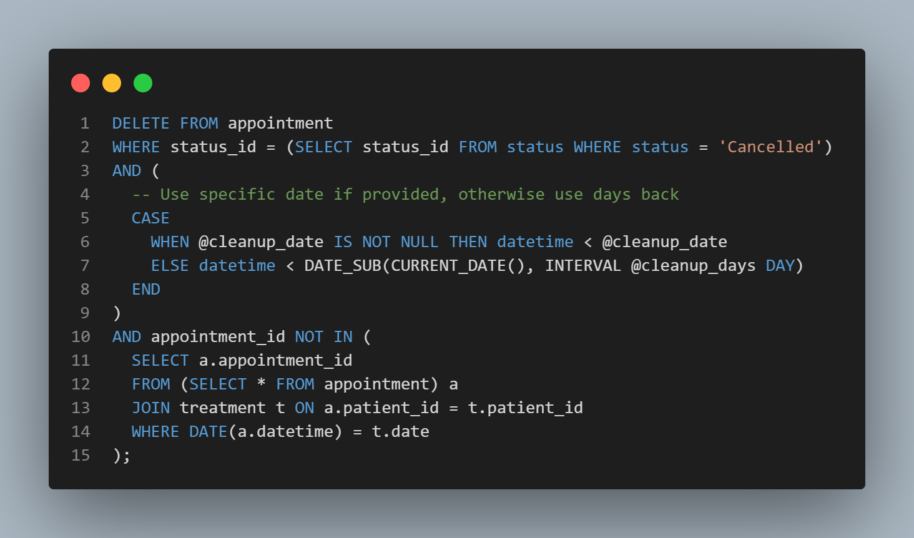
Delete cancelled appointments from history
@param cleanup_date: Specific date to clean up before (e.g., '2024-03-01’) or NULL @param cleanup_days: Number of days back to clean up (e.g., 30) or NULL
Real-world use: Cleaning up cancelled appointments older than X days that have no associated treatments.
Note¹ – The item passed from the web form could possibly be a date or a period of time (in days). This is handled in the CASE statement. [line 5-8]

